Slide 1
Course Code: CSC211A Course Title: Formal Languages and Automata Theory
Lecture 18: Simplification of Context Free Grammar
Course Leader:
Prakash P
prakashp.cs.et@msruas.ac.in

Slide 2
Session Objectives
At the end of this session, student will be able to
Explain substitution rule
Discuss removing useless productions
Explain simplifications of CFG
Describe removing useless productions
Understand removing Nullable variables
Describe unit-productions

Slide 3
Session Objectives
A Substitution Rule
Useless Productions
Simplifications of CFG
Removing Useless Productions
Removing Nullable Variables
Unit-Productions

Slide 4
A Substitution Rule
Equivalent
grammar
Substitute B

Slide 5
General
Substitute B
Equivalent grammar

Slide 6
Useless Productions
Useless Production
Some derivations never terminate...

Slide 7
Another Grammar
Useless Production
Not reachable from S

Slide 8
Simplifications of CFG
In general:
If
Then variable is useful
Otherwise, variable is useless

Slide 9
Simplifications of CFG
A production is useful if all its variables are useful

Slide 10
Removing Useless Productions
Example Grammar:

Slide 11
Removing Useless Productions
Find all variables that produce strings with only terminals
First:
Round 1:
Round 2:

Slide 12
Removing Useless Productions
Keep only the variables that produce terminal symbols

Slide 13
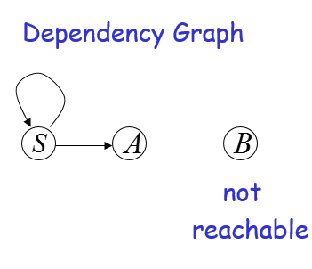
Removing Useless Productions
Second:
Find all variables reachable from

Slide 14
Removing Useless Productions
Keep only the variables reachable from S
Final Grammar

Slide 15
Nullable Variables
Nullable Variable:

Slide 16
Removing Nullable Variables
Example Grammar:
Nullable variable

Slide 17
Removing Useless Productions
Final Grammar
Substitute

Slide 18
Unit-Productions
Unit Production:

Slide 19
Removing Unit Productions
Observation:
Is removed immediately

Slide 20
Removing Useless Productions
Example Grammar:

Slide 21
Removing Useless Productions
Substitute

Slide 22
Removing Useless Productions
Remove

Slide 23
Removing Useless Productions
Substitute

Slide 24
Removing Useless Productions
Remove repeated productions
Final grammar

Slide 25
Removing All
Step 1: Remove Nullable Variables
Step 2: Remove Unit-Productions
Step 3: Remove Useless Variables

Slide 26
Summary
Simplification of CFG consists removing Nullable variables, removing unit-productions, remove useless variables

